Slide 1
University Management System
Guided By : R.S. Sarode Name: Sanket Kulkarni 111708031

Slide 2
Abstract
This project is about the University Management System.
Improved facilities for the people of the administrative end.
Able to enter the data of the students and the teachers.
Also can enter the marks and create results of the students.

Slide 3
Problem Statement
Design a University Management System that can be used by the people at the administrative end helping them to enter the information, student records, teacher records, etc. in very user friendly manner.

Slide 4
Purpose
To manage the details of Students, Classes, Instructors, and Courses.
Built at administrative end and thus only the administrator is guaranteed the access.
Build an application program to reduce the manual work for managing the Students, Registrations, and Classes.

Slide 5
Technologies Used
Database Management
NetBeans IDE
MySQL

Slide 6
Functions
Enter the information of the studnets and the faculties.
Used by the people at the administrative end.
User Friendly Environment enabling the user to save the time and efforts.
Easy gathering of the information from the database.

Slide 7
Operating Environment
Operating System: Windows
Database used : MySQL
Platform : Java
IDE : NetBeans IDE

Slide 8
Dataflow Diagram
Student Details
Details
Database
Administrator
UMS
Final Report
Report

Slide 9
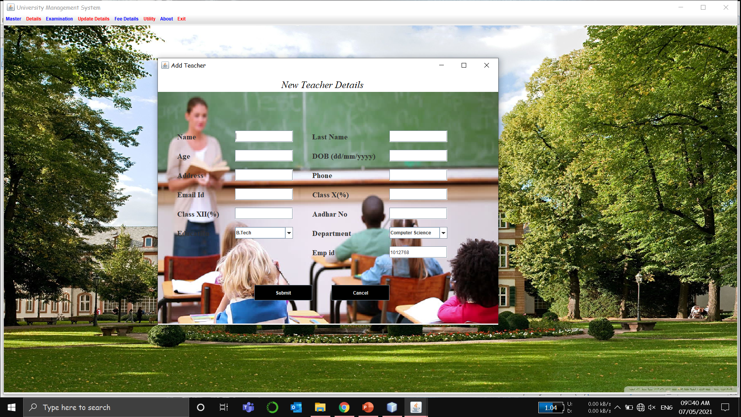
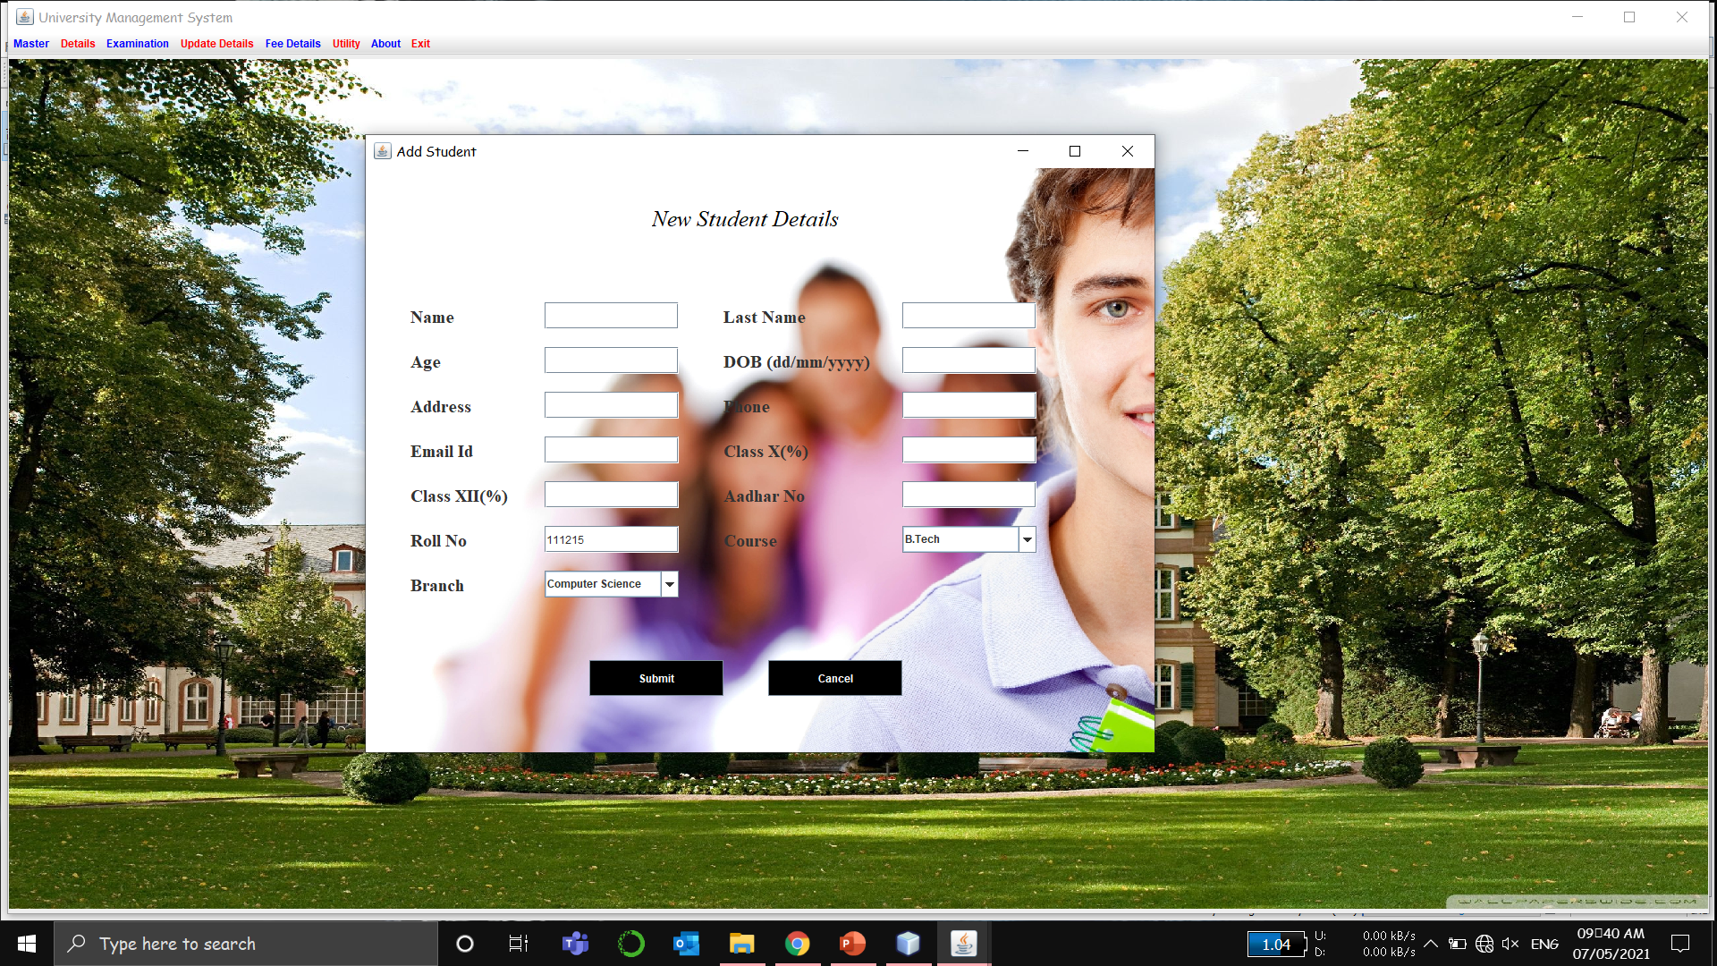
Implementation

Slide 10
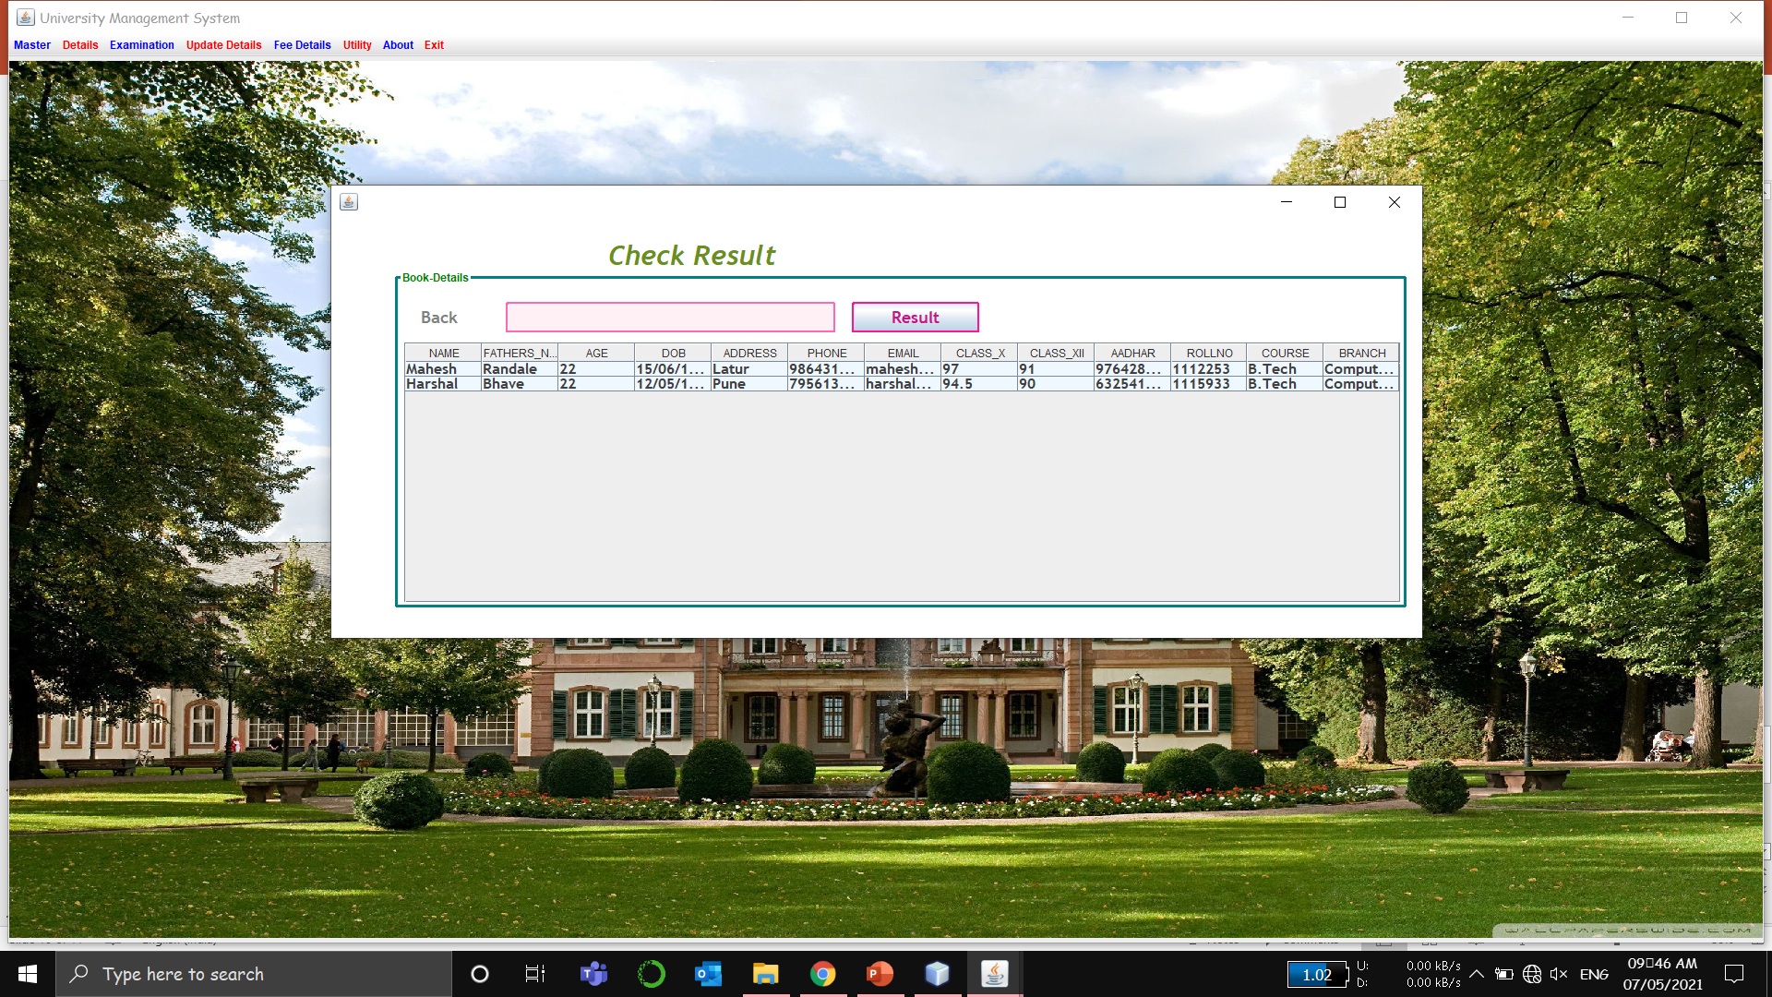
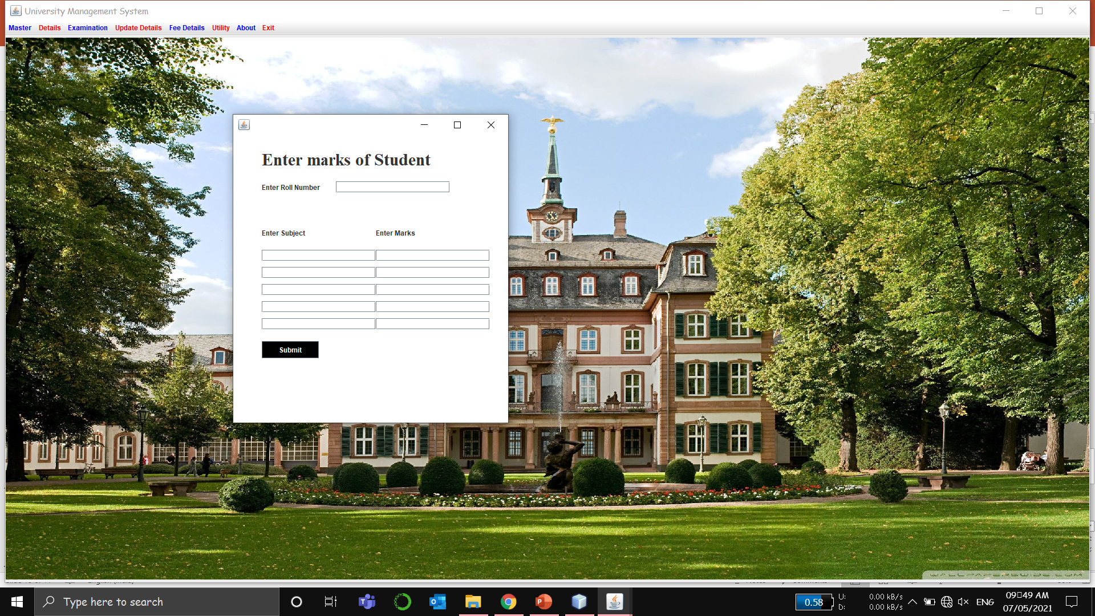

Slide 11
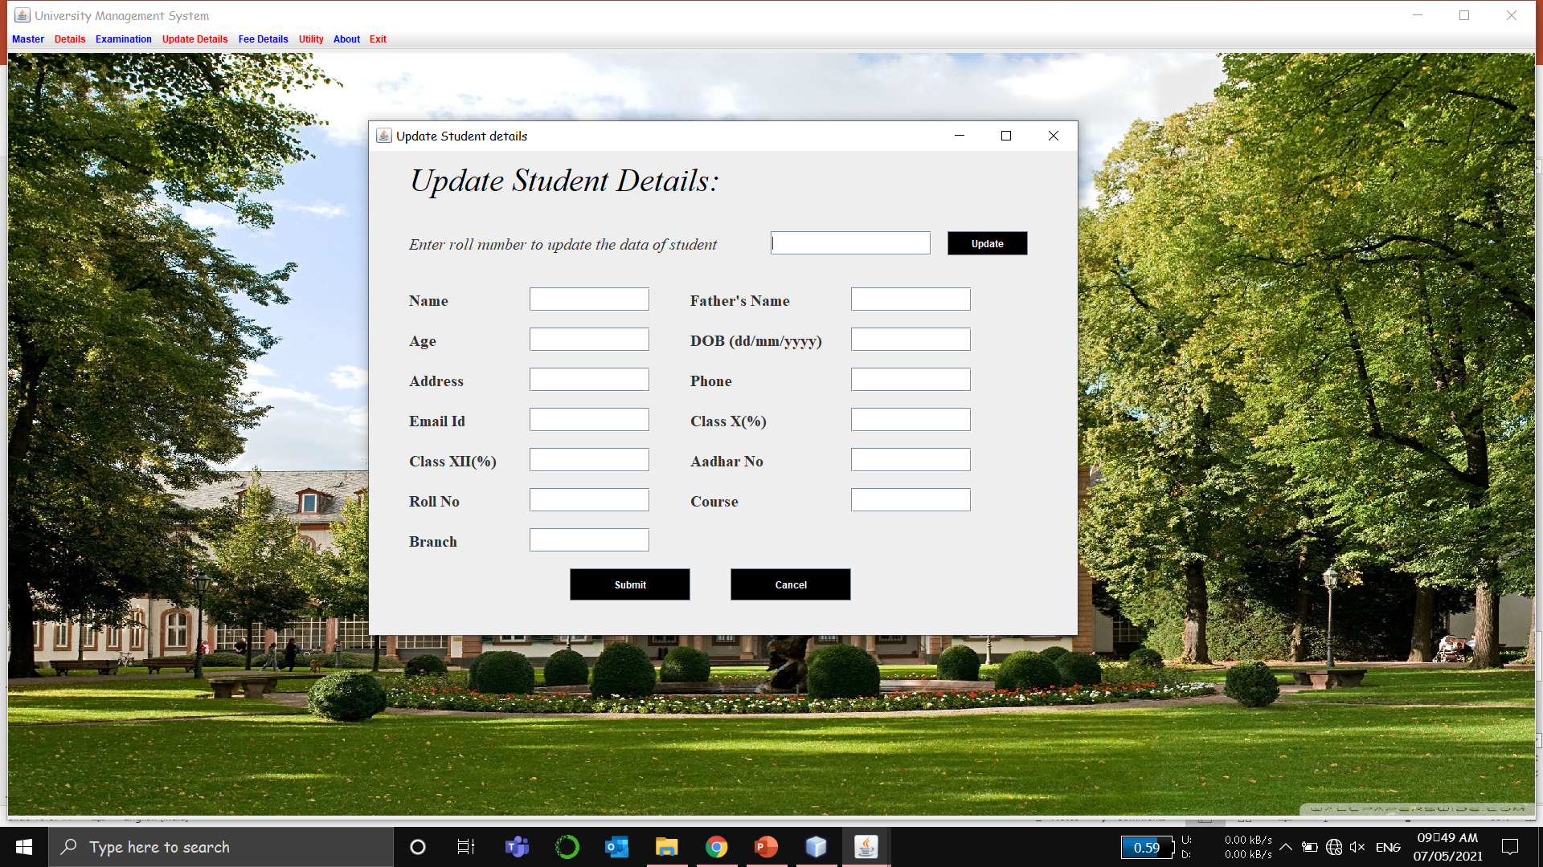


Slide 12
THANK YOU

